Slide 1


Ryan Gilbert
02/04/2026

Slide 2
Outline
Executive Summary
Introduction
Methodology
Results
Conclusion

Slide 3
Executive Summary
Methodological Overview
1. Data Acquisition: Gathered primary SpaceX mission data through API integration and supplementary historical records via Wikipedia web scraping.
2. Processing & Exploratory Analysis: Executed data scrubbing and standardization protocols.
Migrated datasets to a Db2 database for complex SQL querying.
Performed Exploratory Data Analysis (EDA) to uncover initial trends.
3. Feature Engineering: Developed custom variables and applied data scaling/standardization to optimize model input.
4. Visual Analytics: Generated geospatial maps of launch facilities and recovery zones using Folium.
Engineered a dynamic, interactive dashboard via Plotly Dash.
5. Modeling & Validation: Deployed multiple classification algorithms: Support Vector Machines (SVM), Decision Trees, and K-Nearest Neighbors (KNN).
Utilized GridSearchCV for rigorous hyperparameter optimization.
Validated predictive power using test-set accuracy metrics.
Summary of Results
Data Insights
Isolated the key operational variables that correlate with booster recovery success.
Mapped spatial distribution and mission-specific success rates.
2. Model Benchmarking
Decision Tree: Achieved the highest performance with 94.44% accuracy.
SVM & KNN: Tied with a strong performance of 83.33% accuracy
3. Final Conclusions
Critical Drivers: Statistical analysis confirms that launch site location and payload weight are the primary predictors of landing outcomes.
Optimal Solution: The Decision Tree model stands as the superior predictive tool for estimating Falcon 9 reusability.

Slide 4
Introduction
Project Background and Context:
The primary objective of this capstone project is to forecast whether the Falcon 9 first stage will land successfully. SpaceX’s competitive pricing strategy is built upon the reusability of its rocket stages; therefore, establishing a reliable prediction model allows us to approximate launch expenses and offers a strategic edge to competitors during the bidding process.
Core Research Questions:
Variable Analysis: What specific parameters play the most critical role in the successful recovery of a Falcon 9 first stage?
Predictive Modeling: In what ways can we utilize machine learning architectures to anticipate landing results with high precision?
Comparative Performance: Which specific machine learning algorithm yields the highest accuracy for this classification task?

Slide 5

Section 1
5

Slide 6
Methodology
Executive Summary
This study utilizes an end-to-end data science pipeline to forecast the landing success of the Falcon 9 first stage. The workflow integrates automated data acquisition, rigorous preprocessing, exploratory analytics, interactive mapping, and machine learning classification.
Data Acquisition Strategy
Primary data was retrieved via the SpaceX REST API, yielding a comprehensive dataset of flight history, including launch coordinates, payload specifics, and mission recovery statuses.
Data Wrangling & Engineering
The raw data underwent a systematic cleaning process to address null values and standardize formatting. Beyond basic cleanup, we performed feature engineering to derive new predictors and enrich the model's training environment.
Exploratory Data Analysis (EDA)
We combined the power of visual storytelling and structured querying to audit the dataset:
Visual Discovery: Utilized Matplotlib and Seaborn to map correlations between mission success, payload mass, and launch geography.
Structured Analysis: Employed SQL to perform deep-dive queries, extracting nuanced insights and statistical summaries from the flight logs.

Slide 7
Methodology
Interactive Visual Analytics
Geospatial Mapping: Leveraged Folium to design dynamic maps that pinpoint launch locations and visualize mission success trends across different regions.
Dash Application Development: Built a custom Plotly Dash interface featuring interactive filters, such as dropdown menus and range sliders, to facilitate deep dives into payload performance and success probabilities.
Predictive Modeling & Classification
Algorithm Deployment: Developed and benchmarked a variety of classification algorithms, including Logistic Regression, Support Vector Machines (SVM), K-Nearest Neighbors (KNN), and Decision Trees.
Optimization: Utilized GridSearchCV to conduct an exhaustive search for the optimal hyperparameters, ensuring maximum model robustness.
Performance Evaluation: Assessed each model's predictive accuracy to determine the most reliable architecture for forecasting successful first-stage landings.
Source Code: View GitHub Repository

Slide 8
Data Collection
Data Acquisition Pipeline
Phase 1: API Integration (SpaceX)
The process begins by programmatically querying the SpaceX API:
Request Initiation: Sending authenticated calls to retrieve raw flight records.
Data Retrieval: Fetching specific launch parameters (e.g., core versions, landing pad IDs).
Local Persistence: Storing the JSON responses locally for subsequent processing.
Phase 2: Web Scraping (Wikipedia)
To supplement the API data, historical records are extracted from Wikipedia:
Extraction: Scoping out the relevant HTML tables containing launch details.
Parsing: Using the BeautifulSoup library to navigate the DOM and isolate key values.
Structuring: Converting the unstructured web data into organized Pandas DataFrames.
Phase 3: Data Consolidation
The final stage focuses on unifying disparate sources into a single source of truth:
Preprocessing: Aligning indices and features from both the API and Wikipedia datasets.
Merging: Executing a join operation to create a comprehensive mission profile.
Output: Generating the final integrated dataset ready for feature engineering and predictive analysis.

Slide 9
Data Collection – SpaceX API
Data Collection: SpaceX API Integration
The data acquisition process leverages the SpaceX REST API to gather granular mission details through a three-step programmatic workflow.
1. Request Initiation
Methodology: Utilizing Python’s requests library to establish a connection with the SpaceX server.
Endpoint: Hits the version 4 launches endpoint: https://api.spacexdata.com/v4/launches.
Action: Triggers a GET request to fetch the complete history of rocket launches.
2. Response Parsing & Extraction
Serialization: The raw JSON response is converted into a Python dictionary for easy manipulation using .json().
Feature Selection: We filter the large response object to isolate mission-critical fields, including:
Temporal Data: Launch dates.
Geospatial Data: Launch site coordinates.
Technical Specs: Payload mass and rocket configurations.
Target Variable: Mission outcome (success/failure).
3. Transformation & Storage
Structuring: The filtered data is organized into a Pandas DataFrame, aligning variables into a tabular format.
Persistence: The resulting DataFrame is saved locally (typically as a .csv or database file) to provide a stable foundation for the exploratory and predictive phases of the project.
Technical Source: Jupyter Notebook: API Data Collection

Slide 10
Data Collection - Scraping
Data Collection: Web Scraping Wikipedia
To augment the dataset with historical context, we performed web scraping on Wikipedia to extract detailed launch records for the Falcon 9 and Falcon Heavy rockets.
Web Page Retrieval
Methodology: Employed the Python requests library to execute a GET request.
Target URL: Scraped the specialized Wikipedia entry: https://en.wikipedia.org/wiki/List_of_Falcon_9_and_Falcon_Heavy_launches.
Action: Captured the raw HTML source code of the page for downstream parsing.
2. HTML Parsing & Extraction
Library: Leveraged BeautifulSoup to navigate the complex HTML document object model (DOM).
Isolation: Specifically targeted and extracted the <table> elements containing the chronological launch history.
Data Capture: Programmatically iterated through table rows to capture flight numbers, mission details, and recovery outcomes.
3. Transformation & Data Integrity
Tabular Conversion: Transformed the extracted semi-structured data into a structured Pandas DataFrame.
Cleaning Protocols: Performed critical preprocessing steps, including:
Null Handling: Removing or imputing missing mission values.
Standardization: Normalizing column headers and date formats to ensure compatibility with the API-sourced dataset.
Technical Source: Jupyter Notebook: Web Scraping Lab
10

Slide 11
Data Wrangling
Data Wrangling Strategy
Data wrangling serves as the bridge between raw data collection and actionable analysis. In this project, we converted disorganized inputs from multiple sources into a refined, high-quality dataset.
3. Systematic Integration
Dataset Merging: Executed a unified join of the API-derived launch data and the Wikipedia-scraped historical records.
Schema Alignment: Enforced strict consistency in column naming conventions and data structures to create a single, cohesive source of truth.
4. Validation & Quality Assurance
Deduplication: Conducted a rigorous audit to identify and eliminate redundant flight records.
Integrity Checks: Verified the accuracy and logical consistency of entry points to ensure the final dataset was "model-ready.“
Technical Source: Jupyter Notebook: Data Wrangling & EDA
1. Data Cleaning & Imputation
Handling Nulls: Identified missing entries across mission profiles.
Mitigation: Applied statistical imputation to fill gaps or strategically removed records with excessive missingness to prevent model bias.
2. Transformation & Feature Engineering
Format Standardization: Cast variables into appropriate types (e.g., converting strings to datetime objects or numerical floats).
Text Normalization: Cleaned categorical strings by removing whitespace and unifying casing.
Feature Enrichment: Engineered new predictors, such as extracting the specific launch year, and applied feature scaling to ensure numerical consistency across the dataset.

Slide 12
EDA with Data Visualization
Exploratory Data Analysis (EDA) through Visualization
Exploratory Data Analysis (EDA) serves as the diagnostic phase of our project. By visually summarizing the dataset's core characteristics, we can identify underlying distributions, detect anomalies, and uncover predictive relationships between mission variables.
Primary Visual Analytics
Histograms: Used to analyze the frequency distribution of numerical variables like Payload Mass and Flight Number. This allows us to assess data skewness and identify central tendencies within the mission history.
Bar Charts: Essential for comparing categorical outcomes—such as Success vs. Failure rates—across different launch facilities or rocket versions. This highlights which categories yield the most reliable performance.
Line Charts: Deployed to track temporal trends, specifically observing how SpaceX's landing success rate has evolved over the years as their technology matured.
Scatter Plots: Utilized to investigate the relationship between two continuous variables (e.g., Payload Mass vs. Launch Success). This helps determine if heavier payloads correlate with a higher risk of landing failure.
Heatmaps: Generated to visualize the correlation matrix across the entire dataset. These maps are vital for identifying multicollinearity and selecting the most impactful features for our machine learning models.
Box Plots: Used to visualize the spread and quartiles of numerical data. These are particularly effective for spotting outliers and comparing the variance in success rates across different launch sites.
Technical Source: Jupyter Notebook: EDA & Data Visualization

Slide 13
EDA with SQL
EDA with Structured Query Language (SQL)
In addition to visual exploration, we employed SQL to perform precise, structured analysis of the dataset. This allowed for granular data auditing and the extraction of high-level mission statistics.
Key Query Operations
Aggregate Functions: Summarized the entire dataset to calculate the total mission count, tally success vs. failure instances, and determine specific success rates partitioned by launch site and rocket configuration.
Join Operations: Merged disparate tables to correlate core launch records with supplementary metadata, such as technical rocket specifications, creating a holistic view of each mission.
Filtering & Data Subsetting: Used WHERE clauses to isolate specific mission profiles based on temporal windows, rocket types, or outcome categories (e.g., focusing exclusively on "successful" landings).
Sorting & Ordering: Applied ORDER BY logic to chronological data and performance metrics, making it easier to identify temporal trends and performance outliers.
Advanced Subqueries: Leveraged nested queries to compute complex derived metrics, such as calculating the average payload mass per specific launch facility, which provided deeper context for predictive modeling.
Technical Source: Jupyter Notebook: SQL EDA Lab

Slide 14
Build an Interactive Map with Folium
Interactive Geospatial Analysis with Folium
To better understand the geographical distribution of SpaceX operations, we developed an interactive map using the Folium library. This spatial visualization provides critical context regarding launch site proximity to infrastructure and landing zones.
Interactive Map Components
Analytical Value
Geographical Identification: Allows users to visualize exactly where SpaceX conducts missions relative to global geography.
Safety & Logistics: The use of circles helps define proximity zones that may influence launch decisions or safety protocols.
Connectivity: Lines provide clear spatial context, helping analysts understand the relationship between launch points and other mission-critical areas of interest.
Technical Source: Jupyter Notebook: Folium Launch Site Analysis
Object | Implementation | Strategic Purpose
Markers | Placed at exact GPS coordinates for each facility. | Pinpoints precise launch locations for spatial reference and identification.
Circles | Rendered as proximity buffers around each site. | Illustrates safety perimeters, operational boundaries, and regional impact zones.
Lines | Drawn to connect launch sites with key geographical features. | Visualizes spatial dependencies and distances to relevant landmarks (e.g., coastlines or recovery ships).

Slide 15
Build a Dashboard with Plotly Dash
Building an Interactive Dashboard with Plotly Dash
To make the data insights accessible to non-technical stakeholders, we developed a dynamic dashboard using Plotly Dash. This application allows for real-time data exploration through interactive visualizations and user-controlled filters.
Visualization Components
Success Distribution (Pie Chart):
Function: Provides a high-level breakdown of the ratio between successful and failed first-stage landings.
Insight: Enables immediate visualization of SpaceX’s overall recovery performance across the entire mission history.
Success vs. Payload (Scatter Plot):
Function: Maps the correlation between Payload Mass (kg) and Mission Outcome.
Insight: Helps analysts determine if heavier payloads negatively impact the probability of a successful booster landing.
User Interactions
Launch Site Dropdown Menu:
Capability: Allows users to toggle between individual launch facilities (e.g., KSC LC-39A, CCSFS SLC-40, VAFB SLC-4E).
Benefit: Facilitates focused, site-specific performance audits and geographical comparisons.
Payload Range Slider:
Capability: Enables dynamic adjustment of the payload mass parameters shown in the scatter plot.
Benefit: Provides the flexibility to isolate specific mission classes (e.g., small satellites vs. heavy payloads) and observe their unique success rates.
Technical Source: Python Script: Plotly Dash Application

Slide 16
Reasons for Adding Plots and Interactions
Rationale for Interactive Visualizations
The integration of specific charts and user-controlled filters is designed to transform complex raw data into actionable business intelligence.
Strategic Visualization
Success Distribution (Pie Chart)
Objective: Provides an immediate, high-level summary of mission reliability.
Value: Essential for stakeholders to grasp overall performance health and success-to-failure ratios at a single glance.
Payload vs. Outcome (Scatter Plot)
Objective: Uncovers hidden correlations between mission technicalities and recovery results.
Value: Informs operational strategies and payload planning by identifying risk thresholds associated with varying payload weights.
Enhanced User Interactions
Geographical Filtering (Launch Site Dropdown)
Objective: Streamlines the user experience by allowing for site-specific deep dives.
Value: Enables regional benchmarking and comparative analysis between different SpaceX launch facilities.
Dynamic Mass Constraints (Payload Range Slider)
Objective: Facilitates interactive exploration of mission subsets.
Value: Allows analysts to isolate and inspect specific performance factors related to payload mass, offering granular insights into landing success probabilities.

Slide 17
Predictive Analysis (Classification)
Predictive Analysis (Classification)
The core objective of this project is to build a high-fidelity classification model capable of forecasting Falcon 9 landing outcomes. The following workflow outlines the systematic approach used to transition from processed data to a finalized predictive engine.
1. Data Preprocessing & Validation
Standardization: Applied feature scaling to ensure all numerical variables possess a mean of zero and unit variance, preventing models from being biased toward larger-scale features.
Data Partitioning: Split the dataset into training and testing sets to maintain an unbiased evaluation of model performance on unseen data.
2. Model Selection & Configuration
Algorithm Exploration: Evaluated several supervised learning architectures, including Support Vector Machines (SVM), Decision Trees, and K-Nearest Neighbors (KNN).
Task Alignment: Selected models specifically optimized for binary classification tasks (Successful vs. Failed landing) to meet project requirements.
3. Hyperparameter Optimization
Systematic Tuning: Employed GridSearchCV to perform an exhaustive search for the most effective model parameters.
Key Parameters: Tuned critical values such as the regularization parameter C for SVM, max_depth for Decision Trees, and n_neighbors for KNN to maximize predictive power.
4. Rigorous Evaluation & Refinement
Performance Metrics: Assessed model health using a comprehensive suite of metrics: Accuracy, Precision, Recall, and the F1-score.
Cross-Validation: Utilized k-fold cross-validation during the training phase to ensure the models are robust and generalize well to new data.
Iterative Improvement: Refined model parameters based on validation feedback to minimize error rates and maximize reliability.
5. Final Model Selection
Benchmarking: Identified the "Best Performing Model" by comparing accuracy scores achieved on the test dataset.
Overfitting Safeguards: Carefully monitored the gap between training and testing performance to ensure the selected model remains applicable to real-world scenarios without being overfitted to historical noise.
Technical Source: Jupyter Notebook: Machine Learning Prediction

Slide 18
Predictive Analysis (Flowchart)
Predictive Analysis Workflow
The predictive modeling phase follows a structured, iterative pipeline to ensure the highest possible accuracy in forecasting Falcon 9 landing outcomes.
The Modeling Lifecycle
Data Preprocessing: Standardizing features and splitting the dataset into training and testing subsets to prepare for unbiased learning.
Model Selection: Testing diverse classification algorithms—such as SVM, KNN, and Decision Trees—to find the architecture best suited for binary mission outcomes.
Hyperparameter Tuning: Utilizing GridSearchCV to systematically optimize internal model settings (e.g., depth, neighbors, or regularization).
Model Evaluation: Using cross-validation and key performance indicators (KPIs) like Accuracy and F1-Score to measure predictive success.
Improvement Iterations: Refined the models based on error analysis and validation feedback to boost reliability.
Best Performing Model: Selecting the final, optimized champion model based on its performance against the held-out test data.

Slide 19

Section 2

Slide 20
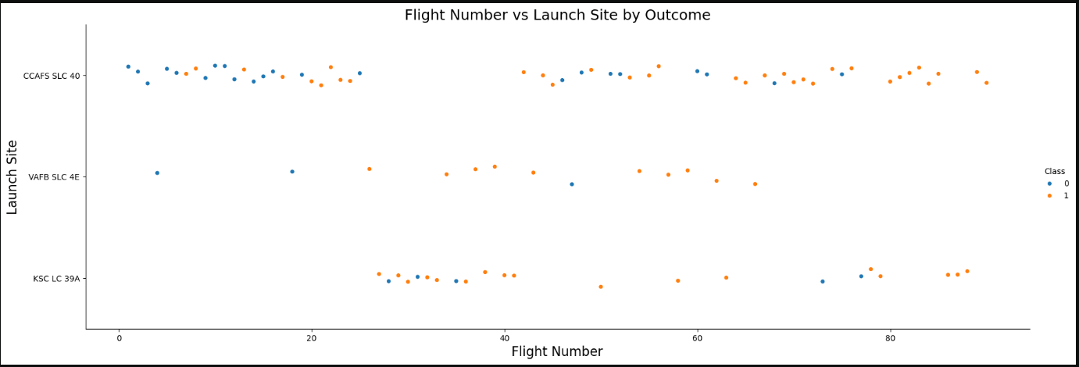
Flight Number vs. Launch Site
Key Observations
Site-Agnostic Success Rates: Analysis of primary launch facilities (CCAFS SLC 40 and KSC LC 39A) reveals a varied distribution of both successful (orange) and unsuccessful (blue) recoveries. This suggests that while geography is a factor, landing success is heavily influenced by external variables beyond the launch site alone.
Operational Continuity: Launch activity is distributed broadly across the flight number spectrum at all major sites. This indicates a steady operational tempo rather than a specific concentration of success or failure tied to a particular phase of the program's timeline.
Absence of Linear Trends: The data does not show a simple linear increase in landing success over time relative to flight numbers, pointing toward the complexity of mission-specific challenges such as payload requirements and weather conditions.
20

Slide 21
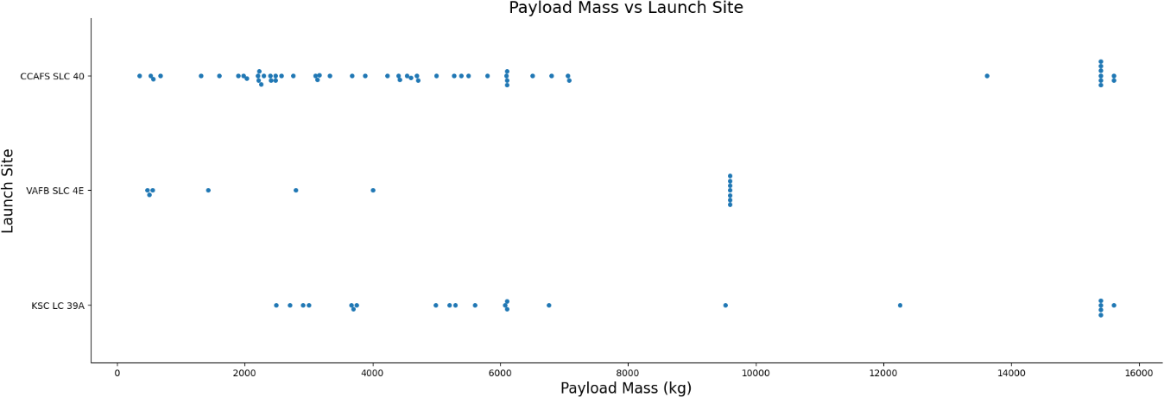
Payload vs. Launch Site
Distributional Insights
Regional Specialization (CCAFS SLC 40): This facility primarily handles "medium-class" missions, with the vast majority of payloads falling below the 10,000 kg threshold.
Mission Versatility (VAFB SLC 4E & KSC LC 39A): These sites exhibit much higher flexibility, supporting a diverse spectrum of mission profiles and a wider variance in payload masses.
Heavy-Lift Capacity (KSC LC 39A): Analysis identifies KSC LC 39A as the primary hub for high-capacity operations. It is frequently selected for missions carrying payloads in excess of 15,000 kg, underscoring its critical role in supporting SpaceX’s most demanding orbital deliveries.
21

Slide 22
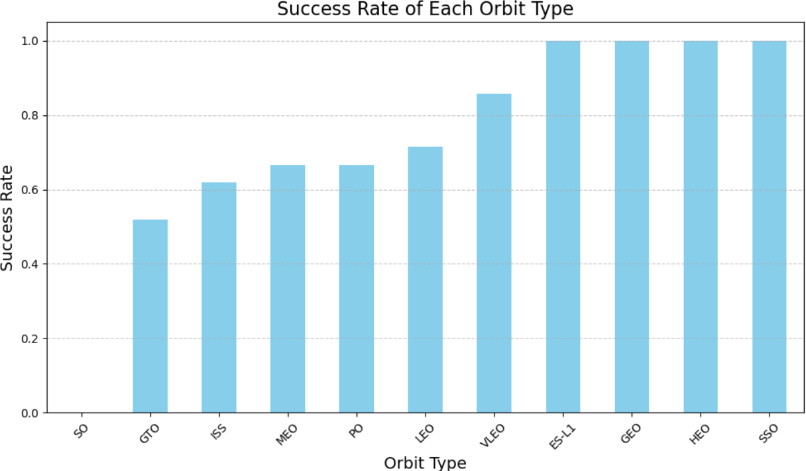
Success Rate vs. Orbit Type
Performance Trends
Optimal Orbit Profiles
Missions targeting VLEO, ES-L1, GEO, HEO, and SSO have demonstrated exceptional reliability, achieving a 100% success rate for first-stage landings. These results suggest that the flight profiles associated with these orbits are highly conducive to booster recovery.
Geostationary Transfer Orbit (GTO) Challenges
In contrast, missions destined for GTO exhibit a notably lower success rate. The increased complexity and higher reentry velocities typical of GTO profiles appear to present greater technical hurdles for successful landing operations compared to other orbital paths.
22

Slide 23
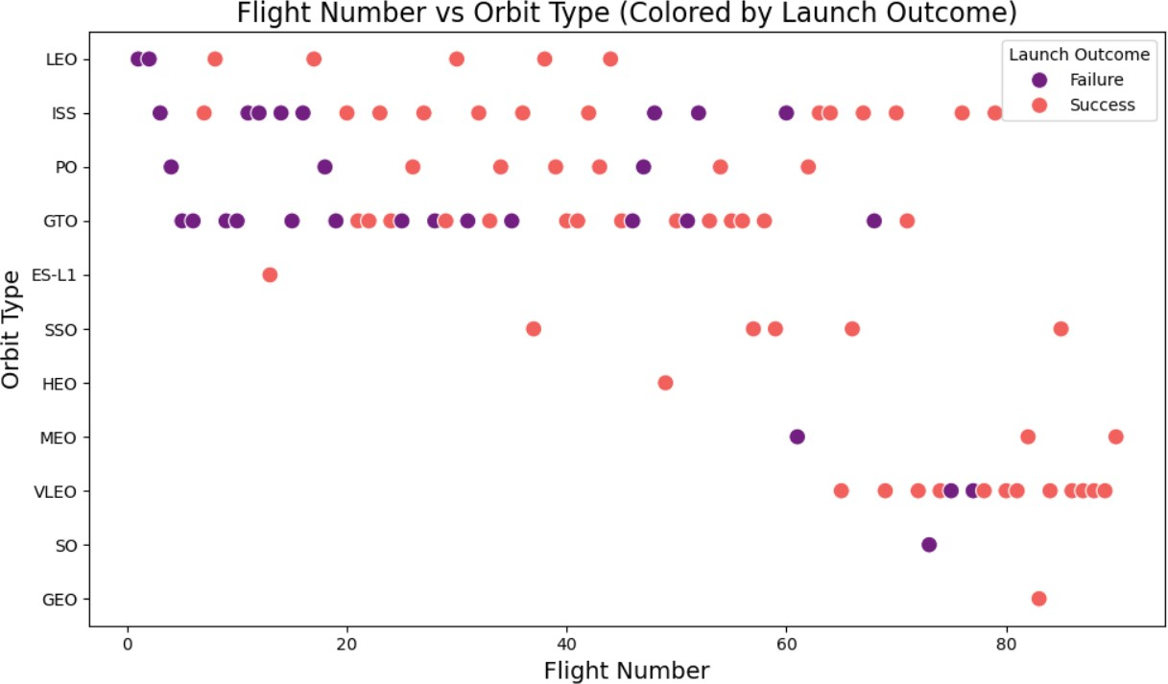
Flight Number vs. Orbit Type
Key Performance Trends
Iterative Success Gains: There is a positive correlation between flight number and landing success. As flight numbers increase, the recovery rate improves significantly, demonstrating that SpaceX's iterative engineering and operational experience have led to more reliable outcomes over time.
Evolution of Complex Missions: Early missions targeting challenging orbits, such as GTO and ISS (LEO) rendezvous, yielded inconsistent results. However, recent flights to these same orbits show a marked increase in success, signaling matured mission planning and technical execution.
Technological Maturity: The transition from mixed results to high-probability success across all orbit types underscores the effectiveness of continuous hardware and software refinements throughout the Falcon 9 program.
23

Slide 24
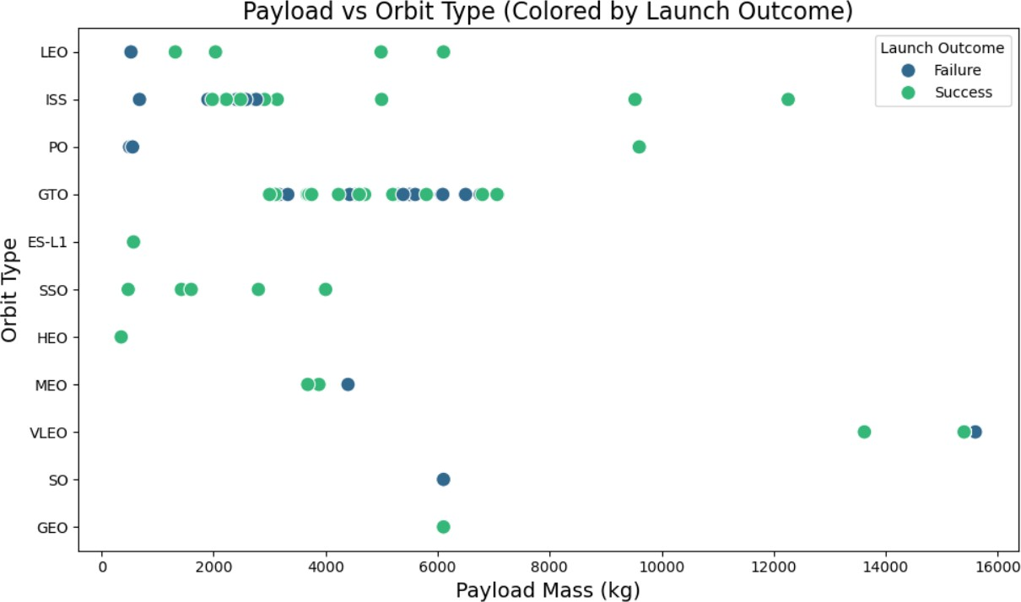
Payload vs. Orbit Type
Key Observations
Optimal Recovery Zone: Successful first-stage landings are consistently observed across all orbital profiles when the payload mass remains below 6,000 kg. This suggests that lighter missions provide a greater margin for error during the recovery phase.
Impact of Mass on Reliability: As payload weight exceeds 10,000 kg, the data shows a higher variance in results, with a mix of successful recoveries and landing failures.
Operational Complexity: The increased frequency of unsuccessful landings with heavier payloads highlights the technical challenges posed by high-mass missions, likely due to the increased fuel consumption and higher thermal stresses encountered during re-entry.
24

Slide 25
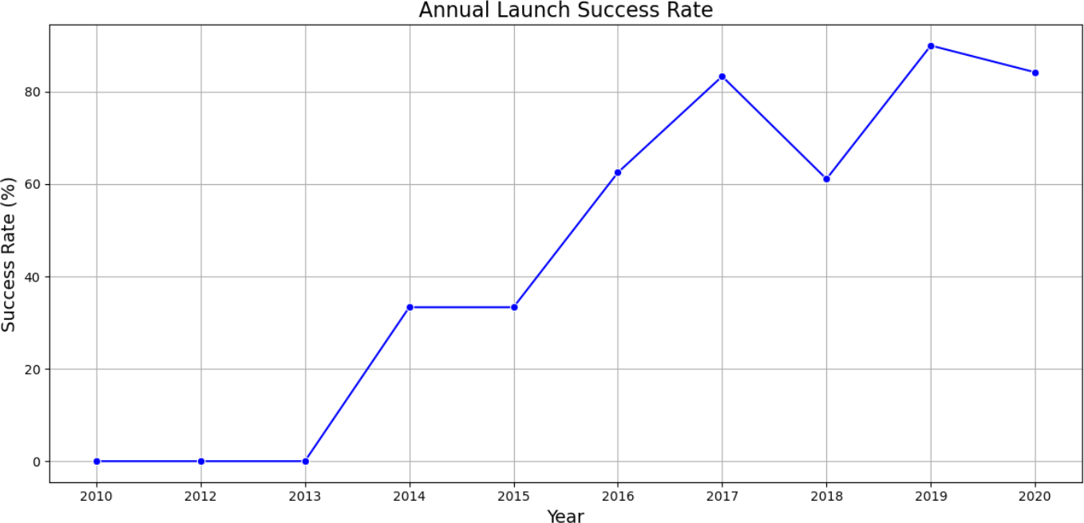
Launch Success Yearly Trend
Temporal Performance Analysis
Sustained Growth: The annual recovery success rate has experienced a dramatic upward trajectory since 2013. By 2020, this figure surpassed the 80% mark, reflecting the successful transition from experimental recovery attempts to standardized operational procedures.
Resilience to Fluctuations: While the program experienced a temporary performance dip in 2018, the long-term trend remained robust. This bounce-back demonstrates SpaceX's ability to learn from mission failures and implement effective engineering corrections.
Maturity & Reliability: The overall longitudinal data highlights a steadily increasing reliability index. The trend confirms that as the platform matured, the "risk-per-launch" for first-stage recovery decreased significantly, solidifying the economic case for reusable rocket technology.
25

Slide 26
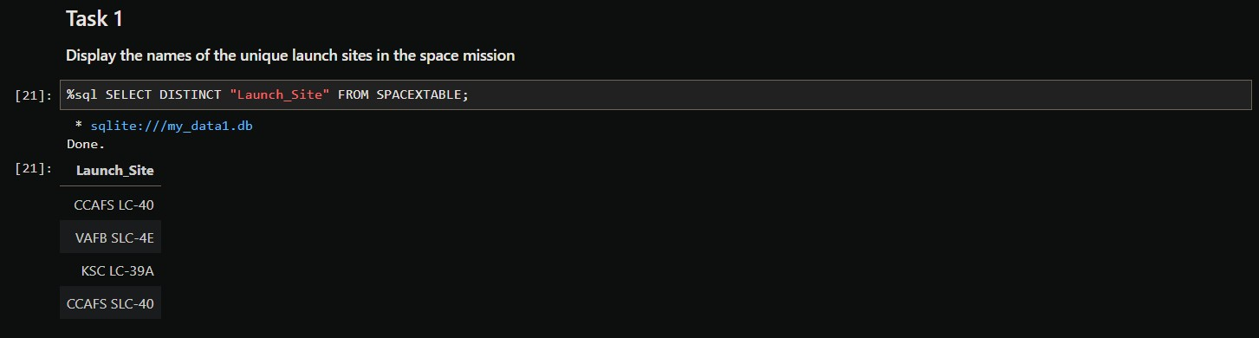
All Launch Site Names

Slide 27
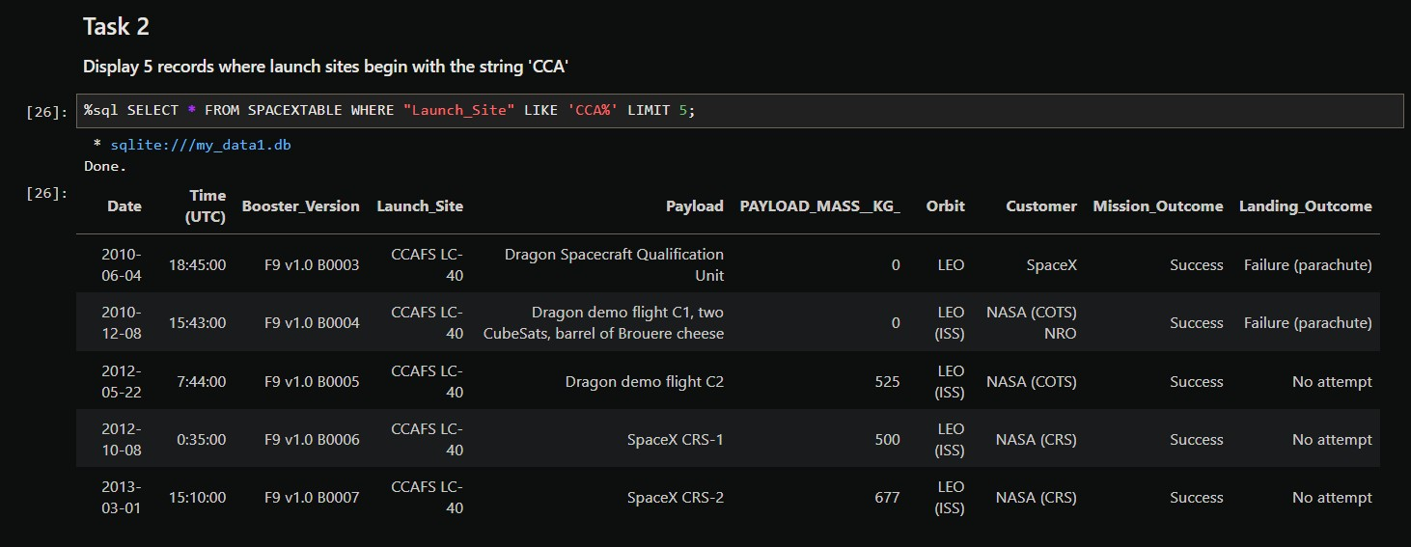
Launch Site Names Begin with 'CCA'

Slide 28
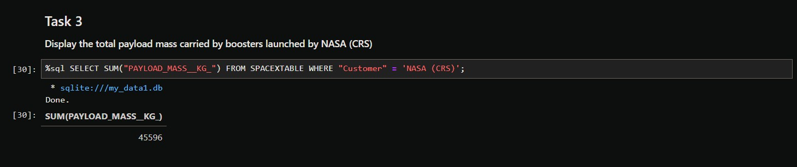
Total Payload Mass

Slide 29
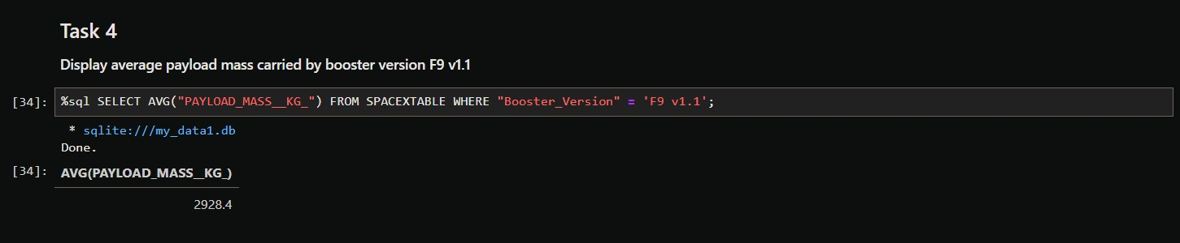
Average Payload Mass by F9 v1.1

Slide 30
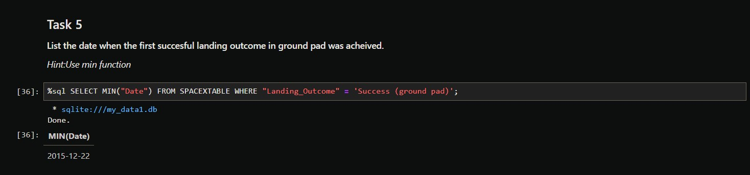
First Successful Ground Landing Date

Slide 31
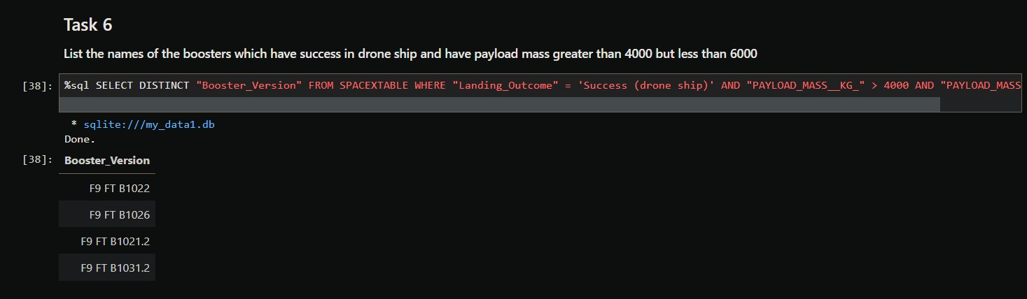
Successful Drone Ship Landing with Payload between 4000 and 6000

Slide 32
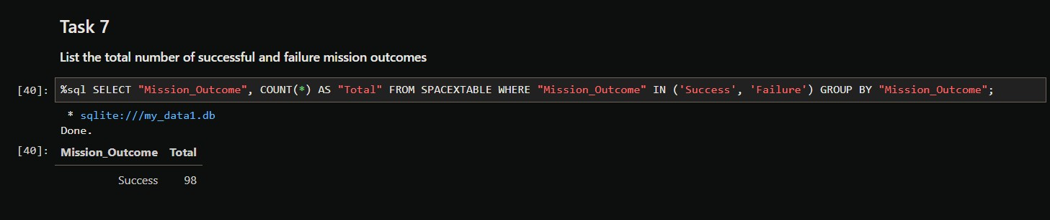
Total Number of Successful and Failure Mission Outcomes

Slide 33
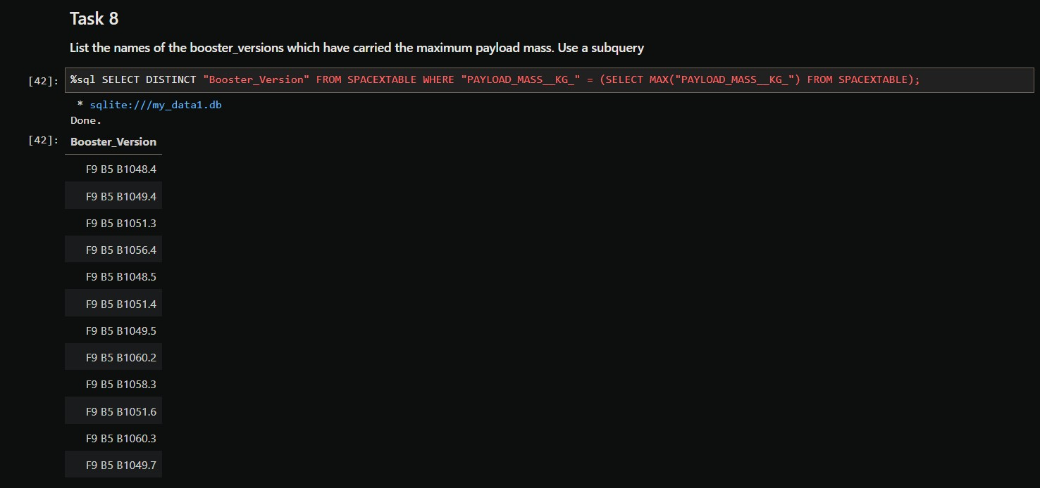
Boosters Carried Maximum Payload

Slide 34
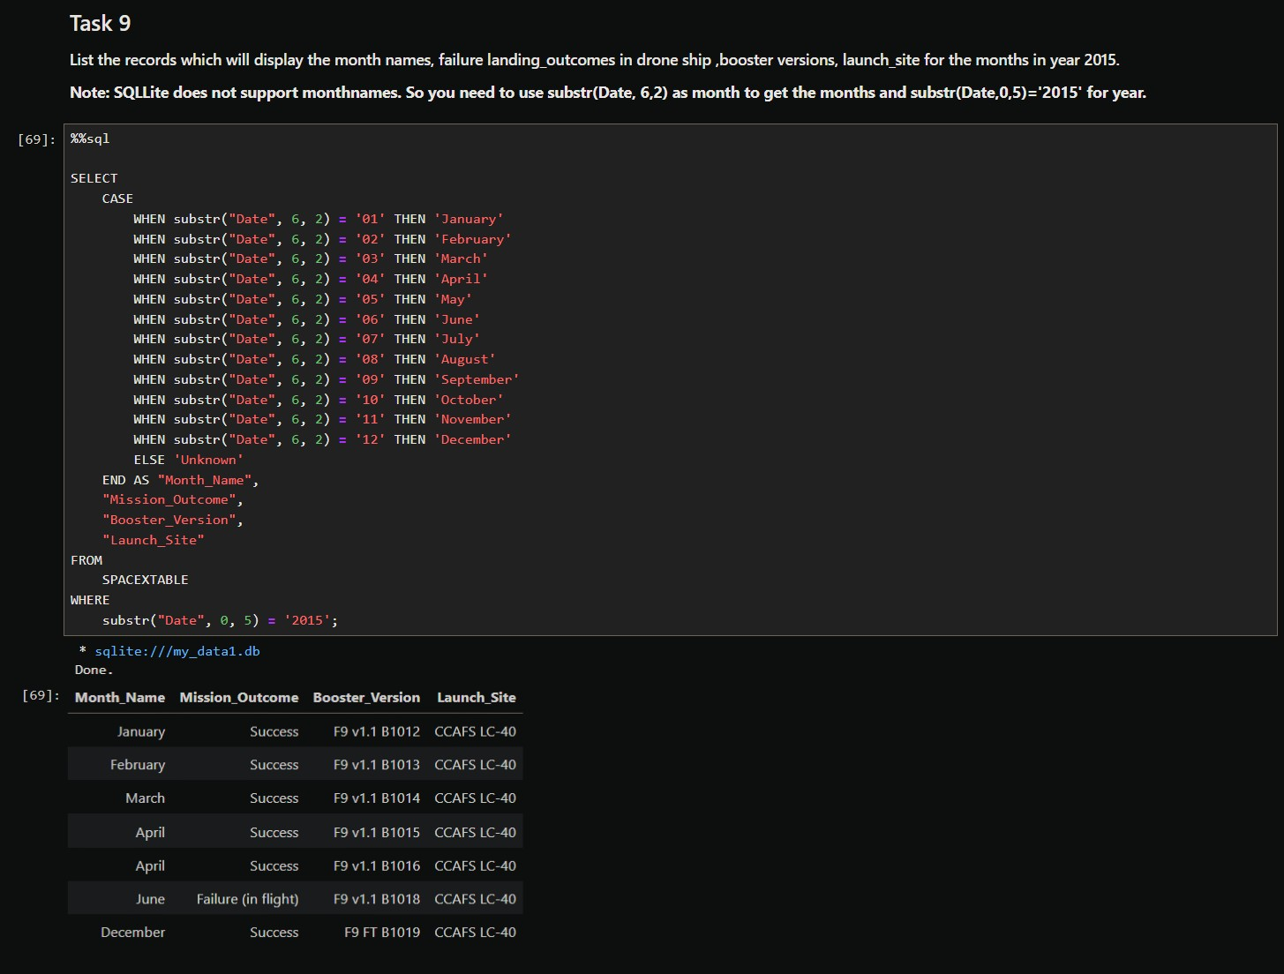
2015 Launch Records

Slide 35
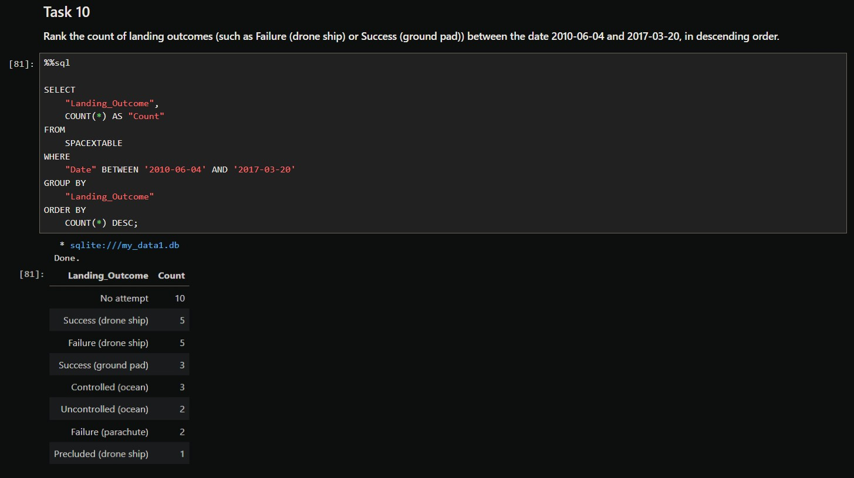
Rank Landing Outcomes Between 2010-06-04 and 2017-03-20

Slide 36

Section 3

Slide 37
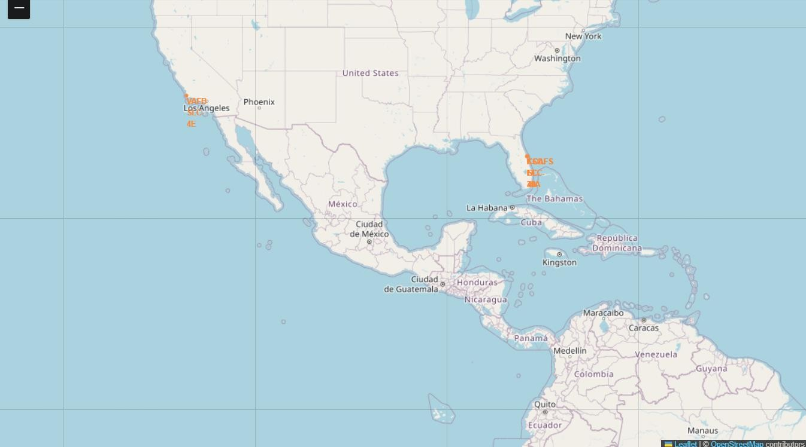
Geospatial Site Analysis
1. Equatorial Proximity
Latitudinal Variation: While SpaceX utilizes sites in southern regions to leverage the Earth's rotational velocity, not all facilities are positioned near the Equator.
Geographical Outlier: Vandenberg Space Force Base (VAFB SLC-4E) is situated at a latitude of 34.63°N, placing it significantly further from the Equator than the primary East Coast facilities in Florida.
2. Coastal Proximity
Strategic Coastal Alignment: All active SpaceX launch facilities are located in immediate proximity to the coastline.
East Coast Presence: The Florida-based sites, Cape Canaveral (CCSFS SLC-40) and Kennedy Space Center (KSC LC-39A), are positioned directly on the Atlantic coast.
West Coast Presence: Vandenberg (VAFB SLC-4E) is located on the California coastline.
Operational Rationale: Coastal positioning is mission-critical for safety, allowing for flight paths over open water and facilitating the recovery of first-stage boosters via autonomous spaceport drone ships (ASDS).
37

Slide 38
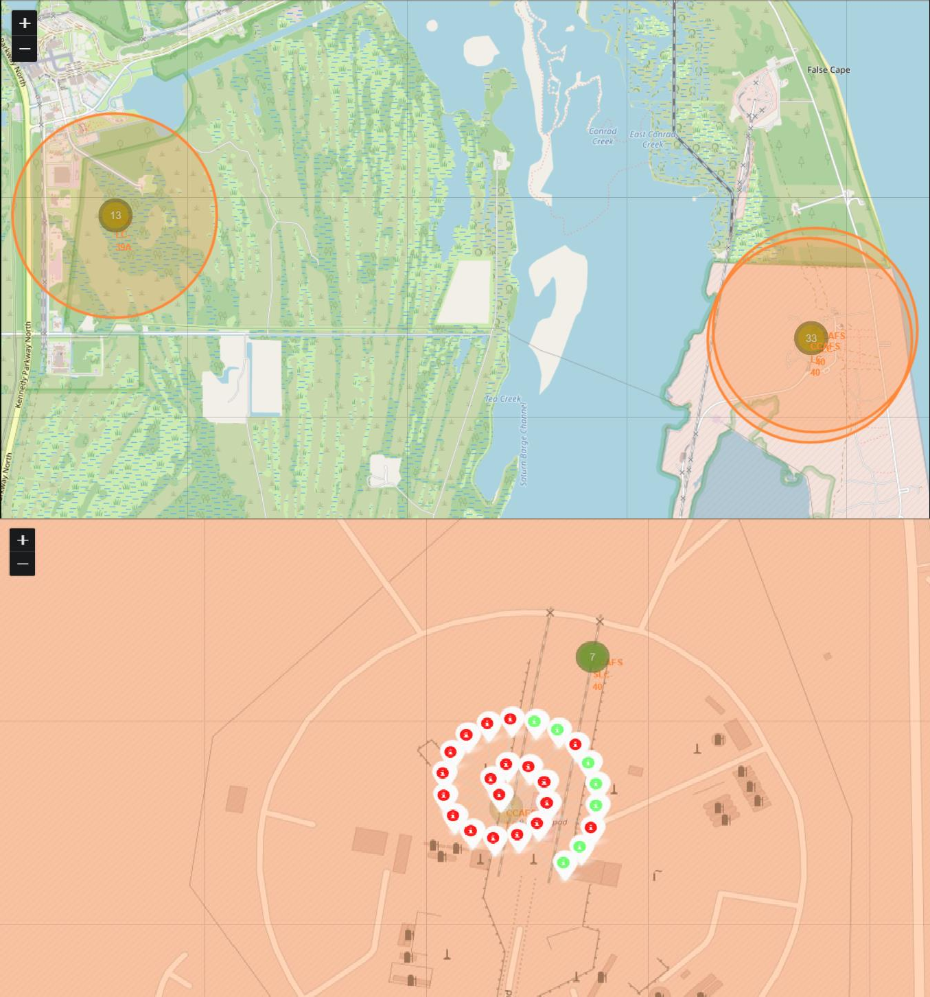
Mapping Launch Outcomes by Site
Visual Analytics Strategy
Marker Clustering: To manage the large volume of launch records without cluttering the map, we implemented a clustering algorithm. This allows users to see an aggregate view of launches that expands into individual markers upon zooming.
Outcome Color-Coding: Each mission is assigned a specific color based on its landing result:
Green Markers: Indicate a successful first-stage landing.
Red Markers: Indicate an unsuccessful landing or mission failure.
Interactive Insights: Every marker is equipped with a popup containing detailed flight information, enabling granular exploration of the specific conditions surrounding each mission.
Case Study: CCAFS LC-40 Performance
Using the provided visualization as a benchmark, we can perform a rapid audit of the CCAFS LC-40 facility:
Mission Count: The dataset captures 26 launches from this specific pad.
Performance Breakdown: The map displays 19 red markers and 7 green markers.
Immediate Insight: This visual feedback highlights that while LC-40 is a high-volume site, it has historically faced significant landing challenges compared to other facilities, providing a clear starting point for deeper diagnostic analysis.
38

Slide 39
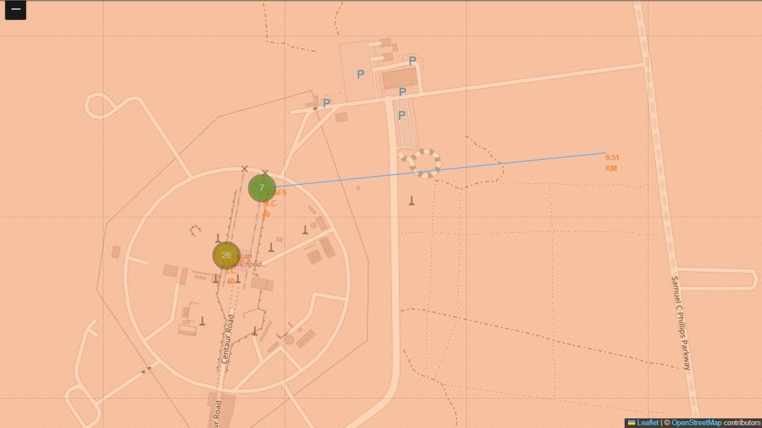
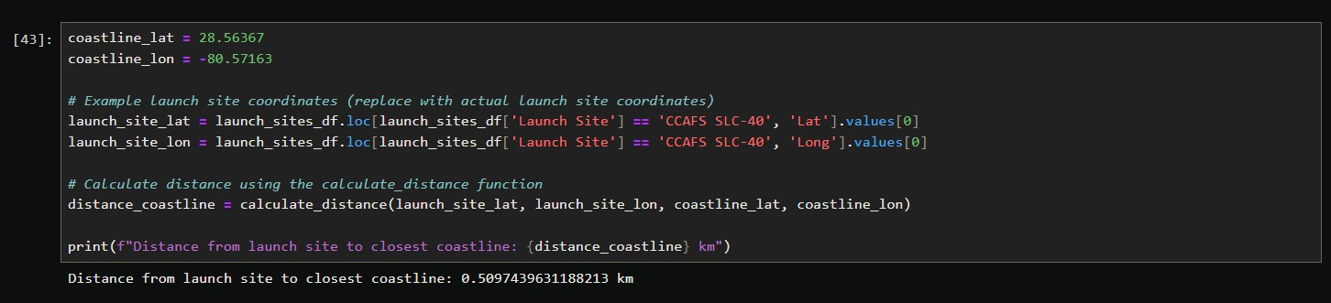
Proximity Analysis: Measuring Spatial Dependencies
Case Study: CCAFS SLC-40 Coastline Proximity
Using the Folium PolyLine tool and a custom distance calculation function, we measured the straight-line distance from the CCAFS SLC-40 launch pad to the nearest point on the Atlantic coast
Calculated Distance: Approximately 0.51 km.
Visual Representation: The map displays a blue PolyLine connecting the site marker to the shore, providing an immediate sense of scale and spatial relationship.
39

Slide 40

Section 4

Slide 41
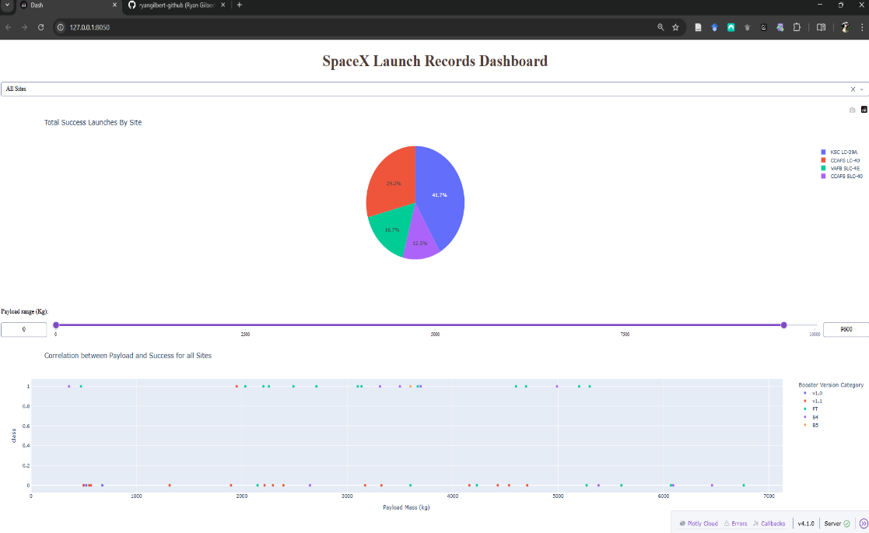
Comparative Launch Success: Site Performance
To identify the most reliable launch facilities for SpaceX missions, we conducted a comparative analysis of the success counts across all primary sites. The following breakdown illustrates the distribution of successful booster recoveries as captured in our interactive dashboard.
Dashboard Integration
These metrics are dynamically calculated within the SpaceX Launch Records Dashboard. By visualizing these proportions in a pie chart, stakeholders can immediately recognize which facilities offer the highest probability of a successful first-stage recovery, aiding in strategic mission planning and bidding estimations.
Launch Site | Success Contribution | Status
KSC LC-39A | 41.7% | Highest Performer
CCAFS LC-40 | 29.2% | High Volume
VAFB SLC-4E | 16.7% | Consistent
CCAFS SLC-40 | 12.5% | Developing
Performance Insights
Operational Leader: Kennedy Space Center (KSC LC-39A) emerges as the premier site for successful missions, accounting for nearly 42% of all recorded landing successes. Its historical pedigree and advanced infrastructure likely contribute to this high reliability.
Secondary Hub: CCAFS LC-40 maintains a strong secondary position, contributing nearly 30% of total successes, underscoring its role as a critical workhorse for SpaceX's launch cadence.
Geographical Distribution: The results show that while East Coast sites dominate the success counts, the West Coast facility (VAFB SLC-4E) provides a steady, successful contribution to the overall recovery portfolio.
41

Slide 42
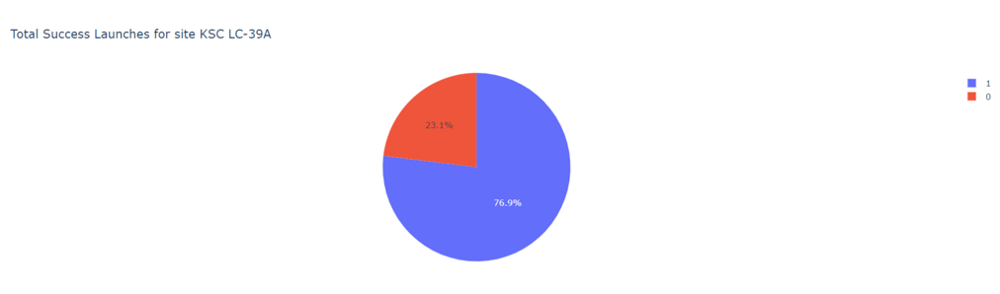
Site Performance Analysis: KSC LC-39A
Internal Success Metrics
The dashboard data reveals that KSC LC-39A maintains an exceptionally high performance standard:
Class 1 (Successful Recoveries): 76.9% * Class 0 (Unsuccessful Recoveries): 23.1%
Performance Insights
Unmatched Reliability: A success rate approaching 77% confirms that KSC LC-39A is the most dependable facility in the SpaceX portfolio for first-stage recovery missions.
Operational Excellence: The vast majority (blue segment) of missions launched from this site result in successful landings, underscoring the site's suitability for high-stakes missions and its role in maximizing booster reusability.
Strategic Benchmark: The performance of LC-39A serves as the primary benchmark for assessing the landing capabilities and reliability of other SpaceX launch facilities.
42

Slide 43
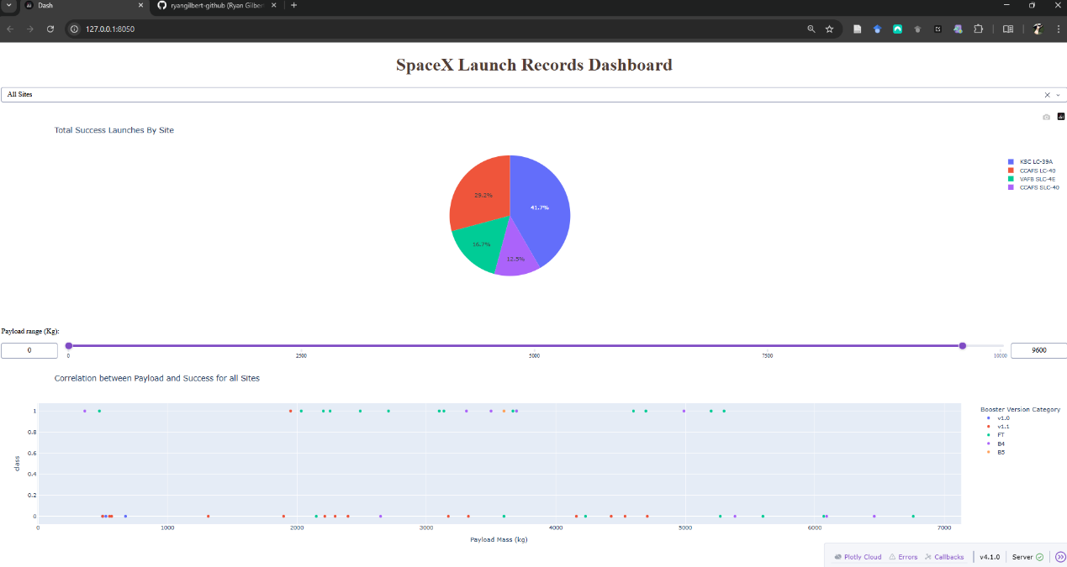
Key Insights from SpaceX Launch Analytics
The interactive dashboard provides a multi-dimensional view of the factors influencing mission outcomes. By synthesizing launch site geography with booster hardware specifications, we can isolate the primary drivers of successful first-stage landings.
Booster Version Performance
The "Workhorse" (FT Version): The Full Thrust (FT) booster version is the most frequently deployed hardware in the dataset. It demonstrates a robust success rate across a diverse spectrum of payload masses, marking it as the most reliable iteration for recovery operations.
Early Iterations (v1.0): The v1.0 booster version accounts for a much smaller sample size. Its limited flight history suggests that it served as an early developmental phase, requiring more data for a definitive performance benchmark.
Mass-Outcome Correlation: Interestingly, the data does not show a linear decline in success as payload weight increases. This indicates that modern booster versions are engineered to handle high-capacity missions without a significant compromise in landing reliability.
Launch Site Success Analysis
Top Performer: CCAFS LC-40 stands out as the most reliable facility among those studied, boasting a peak success rate of 43.7%. This identifies it as a critical operational hub for booster recovery.
Geographical Variability: Facilities such as KSC LC-39A, VAFB SLC-4E, and CCAFS SLC-40 exhibit comparatively lower success rates. This variance suggests that site-specific environmental factors or mission profiles unique to these locations impact recovery probabilities.
43

Slide 44

Section 5

Slide 45
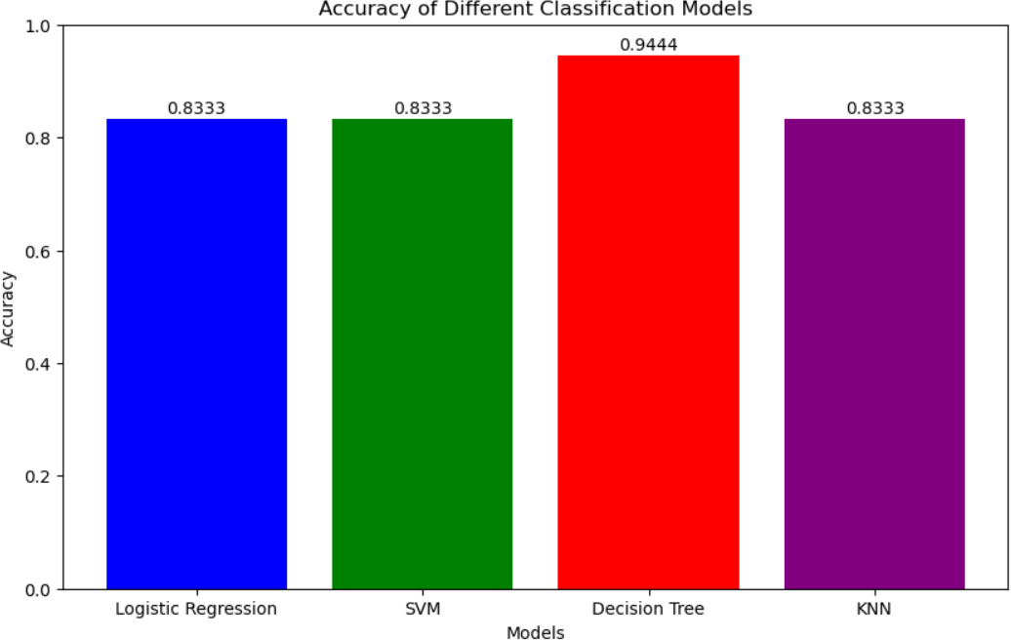
Model Benchmarking: Classification Accuracy
Model | Test Accuracy | Rank
Decision Tree | 94.44% | 1st
Logistic Regression | 83.33% | 2nd (Tie)
Support Vector Machine (SVM) | 83.33% | 2nd (Tie)
K-Nearest Neighbors (KNN) | 83.33% | 2nd (Tie)
To determine the most reliable method for predicting Falcon 9 landing success, we conducted a head-to-head comparison of four popular machine learning algorithms. The following results represent their predictive accuracy on the unseen test dataset.
Key Findings
Superior Performance: The Decision Tree model emerged as the clear champion, achieving a classification accuracy of 0.9444. Its ability to handle non-linear relationships and feature interactions makes it the most effective tool for this specific mission recovery dataset.
Algorithm Consistency: Interestingly, Logistic Regression, SVM, and KNN all converged on an identical accuracy of 0.8333. While these models provide a solid baseline, they were unable to match the nuanced predictive power of the Decision Tree architecture.
Strategic Implication: Given its high precision, the Decision Tree model should be the primary choice for stakeholders looking to estimate launch costs or assess competitive risks associated with SpaceX's booster reusability.
45

Slide 46
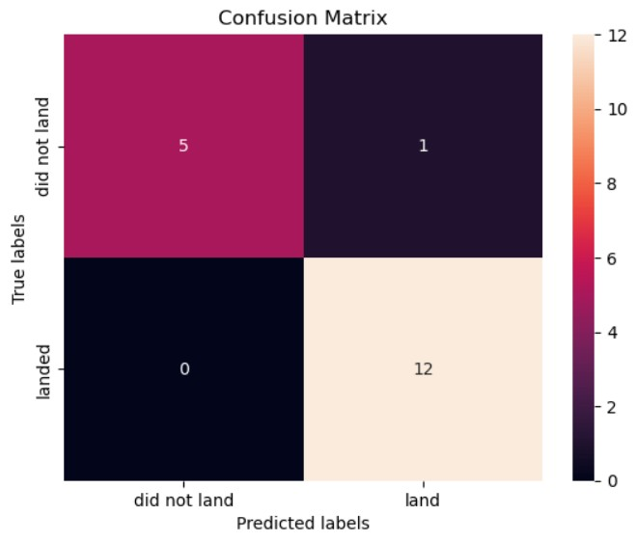
Model Performance: Confusion Matrix Analysis
Key Metrics and Insights
Exceptional Precision (94.44% Accuracy): The model correctly identified nearly all mission outcomes, with a strong volume of True Positives (12 successful landings correctly predicted) and True Negatives (5 failed landings correctly predicted).
Zero False Negatives: This is a standout result. Every actual successful landing was accurately captured by the model. In the aerospace industry, avoiding false negatives is vital for operational readiness and safety, as it ensures no recovery opportunity is overlooked.
Minimal False Positives: The model recorded only one false positive (predicting a success that was actually a failure). From a business perspective, a false positive is far more manageable than a false negative; it results in "over-preparedness" rather than "under-preparedness," which is a safer margin for cost estimation and planning.
Optimized for Industry Needs: The model shows a balanced performance with a slight bias toward predicting success. This aligns perfectly with the practical needs of the aerospace sector, where confirming the viability of a landing is the primary driver for mission bidding and economic forecasting.
Matrix Breakdown
 | Predicted: Did Not Land | Predicted: Landed
Actual: Did Not Land | 5 (True Negative) | 1 (False Positive)
Actual: Landed | 0 (False Negative) | 12 (True Positive)
46

Slide 47
Project Conclusions
Key Analytical Takeaways
Geographical Dominance: The CCAFS LC-40 launch site emerged as the most successful facility, contributing to 43.7% of all recorded landing successes. This indicates that the site’s specific operational workflows and environmental conditions are highly optimized for booster recovery.
Booster Reliability: The "FT" (Full Thrust) booster version demonstrated superior robustness. Analysis shows it maintains a high success rate across a wide range of payload masses, establishing it as the most reliable hardware iteration for sustainable reusability.
Variable Significance: Contrary to initial assumptions, payload mass does not exhibit a clear inverse correlation with landing success. Instead, the data suggests that booster version and launch site conditions are far more influential in determining a mission's recovery outcome.
Visualization Value: The deployment of interactive tools like Folium and Plotly Dash proved essential for uncovering complex geospatial and operational patterns. These visual frameworks allow stakeholders to move beyond raw numbers to gain intuitive, actionable insights.
Final Summary
Our predictive analysis and visual discovery pipeline have established a robust framework for assessing aerospace risk and mission viability. By isolating the technical and geographical drivers of success, these insights provide a strategic roadmap for improving launch strategies and further decreasing the costs associated with reusable rocket technology. The transition from experimental recovery to a data-driven, high-precision operation is a cornerstone of the modern aerospace industry.
47

